Slide 1

29k Technology - Initiation
- Finding Solutions to Challenges in Scaling the Prosperity Architecture

Slide 2
Project0 – Documentation & Domain Reqs Capture
Bird’s eye view into 29k’s Investment Advisory Processes & Strategy
Departments and their Functional Activities, Prosperity Architecture Model
Templates and Sample Reporting Artefacts, their types and methods of Generation and Communications with the Client
Survey of existing Software Solution made available through ZOHO chain of products made to fit Business Process Workflow, along with a set of COTS (Commercial Off-The Shelf) components (PandaDoc etc) and also in collaboration with 3rd Party Client Assessment and Reporting Tools also detailing their tentative/ball-park-estimate of Costing
Capture the existing workflow into Generic High Level Function Definitions, along with Team’s timely support into compiling screenshots of the involved functional activities
Interaction with all Team Members, Deeper look into the Pain Points of different Functional Activities in the complete Workflow
Drive with Stockal for Reporting through Mobile Application, a Tech Collaborative attempt
Looking forward to Scaling through Technology, Embracing Agile Culture
All Documentations available on Git Link: https://github.com/29kAdvisers/documentations

Slide 3
29k – In Review
A Deeper Look into Challenges for Scaling
Pain Points
Client Success Management: to be filled
Advisory: to be filled
Execution: to be filled
Marketing: to be filled
Maintenance: to be filled
Improvement Opportunities in Existing Model
Multiple Websites into a Single Source with better SEO
Inter-Departmental Functional Communications through Ticketing
Workflow/Process Improvements & Automation
Computer Software and Hardware Infrastructure
Departmentalisation and Defining Functional Boundaries
Spend on Products and Tools
Documentation, KT Methods, Information Storage & Sharing
Client Engagement and Reporting

Slide 4


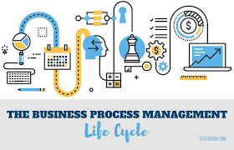
Business Triangle
Solving the Challenges for Scale through the Big 3
People
Technology
Process
Capable Team in the Right Place, at the Right Time
Advanced, Innovative and Highly-Secure Tool Set
Well-Defined, Robust, Flexible and Adaptable Process

Slide 5
Business Triangle Solution Model
People
Organisation Structure & Recruitment Policies
As-Is v/s Proposed Model
Process
Business Process Workflow Management
As-Is v/s Proposed Models
Technology
Building In-House Interface Application
Top 10 Project Listing

Slide 6
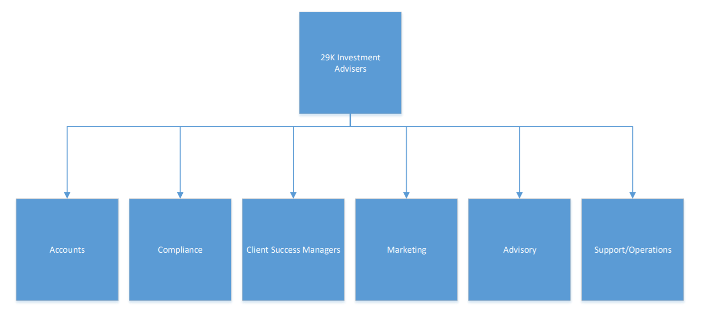
Departments - As-Is

Slide 7
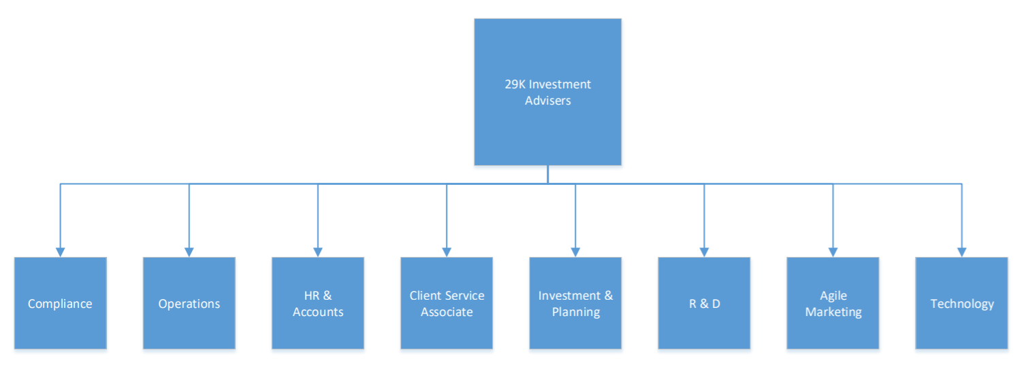
Departments - Proposed

Slide 8
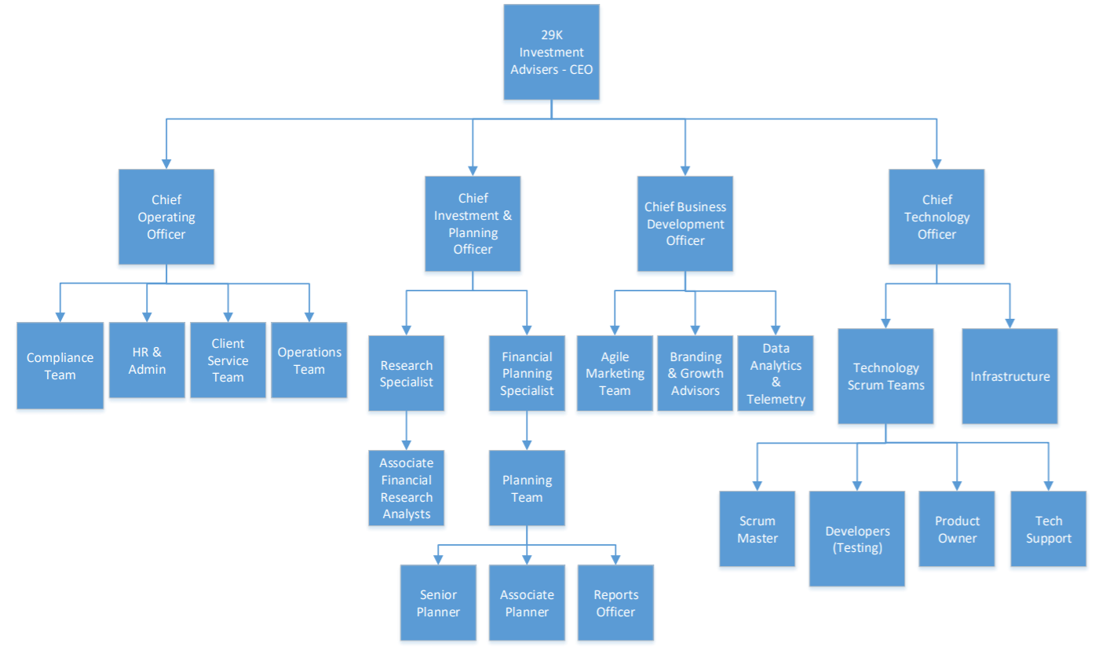
Organization Structure

Slide 9
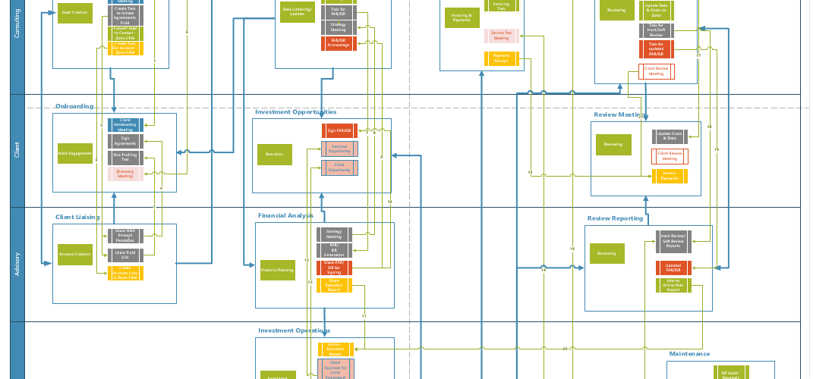
Business Process Workflow - As-Is

Slide 10
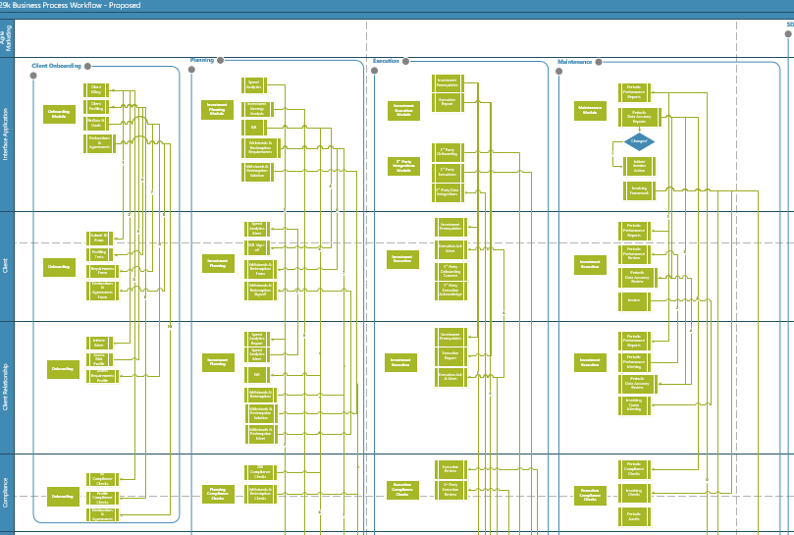
Business Process Workflow - Proposed

Slide 11
Top 10 Projects
Projects in Prosperity Model
Project Scope
Project Goals
Project Outcome
Project Design
Project Estimations
a. Staffing & Effort
b. Time
c. Costing
6. Project Priority

Slide 12
Task Automations & Scaling
Priority
Low
Scope
Goals & Outcome
Goals:
1. Speed up common tasks to lift productivity
2. Reduce Human Errors
3. Provide the team to enough time to add move Value and drive Innovation
Outcome:
Intermediary solution to allow fixed scaling within the stipulated time
Increasing Efficiency and Accuracy
Enhancing the Customer Experience
Improvise the current systems/solutions to accommodate scaling
Mile Stones
Analyse and Identify Redundant Tasks and Pain Points in Detail
Redefine the problem statements
Provide alternative solutions
Provide training material
Measure KPI’s
Estimation
Effort Estimations (Staffing & Manpower):
Team Lead, Program Manager, Business Analyst, Software Dev Team
Timeline Estimations:
3 -4 Months of Effort

Slide 13
Agile & Digital Marketing
Priority
High
Scope
Goals & Outcome
Goals:
1. Speed up common tasks to lift productivity
2. Reduce Human Errors
3. Provide the team to enough time to add move Value and drive Innovation
Outcome:
Activating Leads and Customers
Monetizing existing Leads and Customers
Increasing Sales and Lead Generation
Reduce Churn, Improve Awareness and Customer Satisfaction
Branding, Events and Re-Position
Increase Web Traffic
Refine Go-To-Market Strategy
Mile Stones
Analyze the problem of Main GAIT
Gather objective evidence of Working System
Guide System Developers to Optimal Solutions
Help Evaluate progress towards Goals
Estimation
Effort Estimations (Staffing & Manpower):
Marketing Head, Marketing Team, Business Developer, Solution Architect
Timeline Estimations:
3 Months for Setup, and a recurring process for continuation

Slide 14
Stockal App Maturity
Priority
Low
Scope
Goals & Outcome
Goals:
Ensuring maximum value to the mobile app users
Give business a competitive edge
Spread the use of latest products
Accumulate customer data/statistics for further marketing
Outcome:
Sophisticated one-face application for clients to view their Financial Holding & Valuation
Managing Client Expectations
Driving Stockal for project completion
Managing Information & Integrations
Mile Stones
Survey of Application’s status
Defining Better Boundary Context
Designing/Re-Designing Data Integrations
Ensuring project launch and closure
Support/Maintenance Take Over
Estimation
Effort Estimations (Staffing & Manpower):
Weekly Calls with Stockal and Requirements Refinement
Timeline Estimations:
Dependency on 3rd party vendor, estimated to last in 4 months

Slide 15
Interface App Solution Design
Priority
High
Scope
Goals & Outcome
Goals:
1. design a scalable, thin, extendable, performant, portable micro-service based solution to the process of Investment Advisory Domain
2. adapt and implement using the c4 model
Outcome:
Modular Architecture Diagram, Load Simulation Diagram for all Modules, High Level Architecture for all Modules, Detailed Architecture for all Modules, Finalized Tech-Stack that is to be used, Component Diagrams, Data-Flow Diagram - High Level and Detailed
End-to-End solution designing for Financial/Investment Advisory Domain
Self-Triggered, Retentive, Regulated, Secure, and Single-Page Platform for Client Facing and Transactional Operations
Mile Stones
1. Process based High Level Flow
2. Detailed Sub-Domain definitions for all Processes
3. Modular split of API's & services (micro) for all sub-domains and their abstractions
4. High Level Architecture for all micro-services
5. Detailed Architecture for all micro-services
6. Data Flow Diagrams (High Level & Detailed)
7. Component Diagram
8. UML Diagrams
Estimation
Effort Estimations (Staffing & Manpower):
1 design resource + 2 Subject Matter Experts from Finance/Invest Advisory Domain (weekly 2-3 hours of availability)
Timeline Estimations:
Overall All diagrams can be completed in 4-5 months depending upon the availability of supportive resources
Budget Estimations:
SME's depending upon market analysis, design resource to be picked up as a fresher

Slide 16
Data Modelling
Priority
High
Scope
Goals & Outcome
Goals:
To design Data Model through available abstractions for the Investment Advisory Domain
Outcome:
An implementable Database Design which handles transactional, & analytical needs of Advisory Domain solutions/services
Data Model for Investment Advisory End-to-End process
Data Model for Analytics (secondary ware-houses) - which will be used only later
Mile Stones
1. Data Model for Onboarding process
2. Data Model for Investment & Planning process
3. Data Model for Investment Related Operations(execution) process
4. Data Model for Maintenance process
5. Data Normalisation
Estimation
Effort Estimations (Staffing & Manpower):
1 DB design for reviewing after each Data Model is developed
Timeline Estimations:
`80 Man Days
Budget Estimations:
DB Design Review to be done by Expert

Slide 17
Website Revamp, DDL & SEO
Priority
High
Scope
Goals & Outcome
Goals:
To Implement an appealing Website with Rich Content and Experience
Outcome:
company website in par with best of the Industry
optimised and yielding SEO ensuring better Reachability
optimal user-interface and user-experience
Standardized Website for 29k
SEO comparable to a standard Fortune-500 Organization
One-Stop shop for all info pertaining to the Organization
Clearly Communicable website, web layout, UI-UX designs and Apt content
Mile Stones
1. Web-Design and DDL for 29k
2. Web-Layout Planning and Content Design and Management
3. Web Development, Implementation, Testing and Hosting
4. SEO Application, Meta-Tagging, Search Ranking
5. Content Blogging
6. Digital Art Direction
Estimation
Effort Estimations (Staffing & Manpower):
2 Web-Designer(s), 1 Content Designer, 1 Angular Developer, 1 Digital Marketing Expert, Art Director (contractual)
Timeline Estimations:
Overall All diagrams can be completed in 4-5 months depending upon the availability of supportive resources & continuity to be on-going
Budget Estimations:
~ 2 Lakhs (one-time investment) + employee compensations

Slide 18
Technology Vision, Principles, Roadmap
Priority
Medium
Scope
Goals & Outcome
Goals:
To provide Engineering Vision, Matrix and Roadmap for Technology Department of the Organisation
To provide principles and guidelines, framework for Technology decision making and design philosophies
Outcome:
Established Technology Department and Solution ecosystem for Business Challenges in 29k
Define Technology Vision & Roadmap, Technology Matrix, Technology Processes, Maintain Technology Systems
Setup SharePoint/Company Internal Communication Web Portal
Define As-Is and Proposed Technology Landscape, Ticketing
Budgeting for technology
API and Endpoint, and Technology Standards and Decision Making Frameworks
Mile Stones
Estimation
1. SharePoint site for Organisation, System Listing, SDLC-Agile Manifesto as Process, Roadmap Definitions
2. Implement Ticketing for inter-departmental communications, and KPI metrics design and implementation
3. API and Tech Stack, Technology Matrix Framework Design
4. System Maintenance and related detailing
5. Budget Forecasting & Handling for Technology dept.
Effort Estimations (Staffing & Manpower):
CTO Role
Timeline Estimations:
Requires detailed study and research on state-of-the-art Technology implementations
Budget Estimations:
CTO Salary

Slide 19
Technology Infrastructure Setup
Priority
Medium
Scope
Goals & Outcome
Employee Resource Allocation (System Requirements, Maintenance(Repair), Contingency Planning, timelines for allocation, Vendor Management, Usage Policy) and mechanism for implementation/enforcement
Office Server Setup - For Internal Website hosting, Application Deployment and Testing, Disaster Recovery Planning, Server Contingency & Design, Shared Drive, Databases, Network & Communications
Product Procurement - Software/Hardware/Service Procurement Process Implementation, Documentation & Blacklisting/Whitelisting
- 24x7 Infrastructure Support & Issue Management, Change Management Policies
To provide a self-sustained technology infrastructure environment for apt functioning of existing processes in parallel, along with opportunities for scaling and for detailed project execution of Solution Architecting for the Investment Advisory Domain
To provide process definitions relating to 29k's Maintenance, Support and Technology Infrastructure Operations
To ensure DevOps setup and cost-effective solutions for Software Testing & Deployment in On-Prem and Cloud environments
To ensure Asset Management and facilitate procurement related to Technology
Mile Stones
Estimation
1. Product/Service/Tools Product Listing, Procurement Procedure and related implementation and documentation
2. Internal Server Setup – Hyper-vising, and related planning, design and setup with Disaster Recovery
3. Cloud Competitor Analytics - Resource & related Contingency Planning
4. Employee Resource Allocation and related Policy making & implementation
5. Infrastructure Costing, and Spend Analytics process definition
6. Infrastructure Management Process Support Policy & setup
Effort Estimations (Staffing & Manpower):
A continuous and evolving process
Each milestone can be handled in parallel with minimum/low dependency
Setup would involve dependency on 3rd Party/Vendors as Stakeholders, effective timelines can only be deduced after detailed breakdown
Post the complete setup and implementation - An infrastructure Team of at least 2 members until the org holds up to 100 employees.
9 – 10 Months

Slide 20
Policy, Process Alignment & Recruitment
Priority
Medium
Scope
Required Set of Base Policies - https://resources.workable.com/company-policies/
Following Processes:
a. Customer Acquisition & Marketing
b. HR & Finance (Accounting)
c. Technology & Product Development
d. Quality & Product/Service Delivery
e. Management
Goals & Outcome
Goals:
1. To have an established setup of policies and processes as per the standards of Fortune-500.
2. Simple, Implementable, Extendable, Relevant & Reliable policy and process definitions meeting SMART benchmark
3. To lay principles for Work-Ethics, Philosophies, Self-Development & Performance
4. To build framework to ensure adherence to legal & regulatory terms for our service renderings
5. To ensure great Work-Culture & transparency through up-to-date Organisational Policies
6. To ensure Continuous Improvement through Core Process Designs & Architecture
Mile Stones
Estimation
0. Lead Time for Basic Survey and Planning
1. Employee & Recruitment Policies Definitions
2. Customer, Information Security & Legal Regulatory Policies Definitions
3. Operational Policies & SLA Definitions etc.
4. Organization Structure
5. Process Scoping & Roadmap Designs
6. Process Objectives, Implementation Plan & Scheduling
7. Process Maturity Gauging Mechanism Design
Effort Estimations (Staffing & Manpower):
1 Content Writer, + Core Team
Timeline Estimations:
220 Man Days
Budget Estimations:
~ Relatively Low

Slide 21
Thank you.

